Slide 1


DEPI Graduation Project
Project 3 : Advanced Wireless Network Setup & Security
Applied on Small Hotel Wireless LAN
click to navigate to project repository

Slide 2
Team Members :
Saif-aleslam Mohammed Mohsen
Marwan Hamdy Mohy Eldin
Mohammed Raafat Al-Hennawy
Jana Mohamed
Yousef Ayman
Survived By Eng : Amr Adel

Slide 3
Project Overview
We aim to apply Project No. 3 on a wireless local area network for a small hotel, where the network consists of user devices, network devices and some protocols used in Cisco devices that aim to enhance performance and security, as we aspire to simulate a network that does the following :
Isolate hotel guests from the hotel system by providing a dedicated wireless network.
Establishing a network of staff in the hotel that provides connectivity for both guest service and reception.
The network of managers where they can manage the hotel .
The Isolated network for security and surveillance cameras .
Finally, the technical support network and IT officials , which in turn can access all hotel networks, from guests to management.

Slide 4
System Features
System Users
  (Guests , IT & Technical Support , Management , Staff, Security)
  The maximum Number of Guests at the same time is 150 or more Guest
  At most 10 devices with managerial Access
  Hotel Staff Number may Grow so the network of staff should be allow Devices more than the number of the actual Staff Number which now is 30 .
  Just 4 or more PCs With IT Accessibility

Slide 5
CON..
System Expected Devices
  Because the system is responsible for a small hotel, the number of devices responsible for controlling and configuring this system will not be in large numbers so as not to be a waste of resources ;
  SO we expect that the system will consist of the following :
  A maximum of two Cisco routers type 2911
  Max 4 Cisco Switch Multi-layer Device 3560-24BS
  Maximum number of 10 Cisco Switch devices type 2960 IOS15
  Maximum 15 Cisco lightweight LAP-APT access points
  Max 3 x WLC-3504 wireless controller
  Maximum of 2 Cisco AP-APT devices
Considering that each room in the hotel has a computer connected to the network,, and considering the presence of surveillance cameras with various other end-users' devices, whose exact number is difficult to determine because it is a destination for Scalability.

Slide 6
Network Design
The hotel consists of multiple buildings for administration and a guest building ;
where The administration building consists of multiple floors , the floor consists of the administration department , HR , floor for security and surveillance department , and the central Devices responsible for the network Control and Configuration , and it belongs to IT and technical support officials only ;
as for the other building, it consists of Guests floors, the ground floor for reception and guest service, Restaurant , Waiting Area and the rest of the upper floors are for guests .
Guest Building Access The Network Wirelessly Except Few Things .

Slide 7

CON..

Slide 8
Network Devices Configuration Overview
1: Cisco Switch Configuration – Guest_Core1
VLAN Design, Security, and Redundancy
IOS Version: 12.2(37)SE1
Routing Enabled: ip routing
Service Encryption: service password-encryption
SSH Access Enabled (VTY lines 0-2)
Domain Name: Guest_Core1.com

Slide 9
Security & Authentication
Enable Secret: Encrypted (MD5)
Local User: GuestCore1 (Encrypted Secret)
Console Line: Password protected, login required, logging synchronous
VTY 0-2: Login local (SSH only)
VTY 3-4: Login only (no SSH restriction)
Spanning Tree & EtherChannel
Spanning Tree Protocol: PVST
Trunk Encapsulation: 802.1Q (dot1q)
Native VLAN: 99
EtherChannel Groups: Port-Channel1 to 5 (LACP active mode)
Interface Summary
Trunk Ports grouped via EtherChannel:
  Fa0/1, Fa0/2 → Po5
  Fa0/10, Gi0/1 → Po2
  Fa0/13, Fa0/14 → Po3
  Fa0/17, Fa0/18 → Po4
  Fa0/23, Fa0/24 → Po1
Access Ports: Fa0/15 (VLAN 20), Gi0/2 (VLAN 50)
Shutdown Ports: Fa0/3–9, 11–12, 16, 19–22

Slide 10
VLAN Interfaces (SVIs) , HSRP
VLAN | IP Address | MAC Address | HSRP | Helper Addresses
VLAN10 | 192.168.10.4/24 | 0001.9764.1301 | 192.168.10.1 (Priority 200, Preempt) | 50.0.0.10, 16.0.0.10, 17.0.0.10, 100.0.0.10
VLAN16 | 16.0.0.2/28 | 0001.9764.1302 | 16.0.0.1 (Priority 200, Preempt)
VLAN17 | 17.0.0.3/28 | 0001.9764.1303 | 17.0.0.1 (Priority 150, Preempt)
VLAN20 | 192.168.20.4/25 | 0001.9764.1304 | 192.168.20.1 (Priority 50, Preempt) | 50.0.0.10, 100.0.0.10, 17.0.0.10, 16.0.0.10
VLAN30 | 30.0.0.4/26 | 0001.9764.1305 | 30.0.0.1 (Preempt) | 50.0.0.10, 16.0.0.10, 17.0.0.10, 100.0.0.10
VLAN40 | 10.0.0.4/26 | 0001.9764.1306 | 10.0.0.1 (Preempt) | 50.0.0.10, 16.0.0.10, 17.0.0.10, 100.0.0.10
VLAN50 | 50.0.0.4/28 | 0001.9764.1307 | 50.0.0.1 (Preempt) | 50.0.0.10, 16.0.0.10, 17.0.0.10, 100.0.0.10
VLAN60 | 172.16.1.4/26 | 0001.9764.1308 | 172.16.1.1 (Priority 50, Preempt) | 50.0.0.10, 16.0.0.10, 17.0.0.10, 100.0.0.10
VLAN80 | 80.0.0.4/26 | 0001.9764.1309 | 80.0.0.1 (Priority 50, Preempt) | 50.0.0.10, 16.0.0.10, 17.0.0.10, 100.0.0.10
VLAN100 | 100.0.0.4/28 | 0001.9764.130a | 100.0.0.1 (Preempt)
VLAN120 | 120.0.0.4/24 | 0001.9764.130b | 120.0.0.1 (Priority 110, Preempt) | 50.0.0.10, 16.0.0.10, 17.0.0.10, 100.0.0.10
VLAN125 | 125.0.0.4/26 | 0001.9764.130c | 125.0.0.1 (Priority 150, Preempt) | 50.0.0.10, 16.0.0.10, 17.0.0.10, 100.0.0.10
VLAN150 | 150.0.0.3/24 | 0001.9764.130d

Slide 11
Network Devices Configuration Overview
2: Cisco Switch Configuration – Guest_Core2
VLAN Design, Security, and Redundancy
IOS Version: 12.2(37)SE1
Routing Enabled: ip routing
Service Encryption: service password-encryption
SSH Access Enabled (VTY lines 0-2)
Domain Name: Guest_Core2.com

Slide 12
Security & Authentication
• Enable Secret: Encrypted (MD5)
• Local User: GuestCore2 (Encrypted Secret)
• Console Line: Password protected, login required, logging synchronous
• VTY 0–2: login local (SSH only)
• VTY 3–4: login (no SSH restriction)
Spanning Tree & EtherChannel
• Spanning Tree Protocol: PVST
• Trunk Encapsulation: 802.1Q (dot1q)
• Native VLAN: 99
• EtherChannel Groups:
Port-Channel1
Port-Channel2
Port-Channel4
Port-Channel5
(All using LACP active mode)

Slide 13
Interface Summary
Trunk Ports grouped via EtherChannel:
Fa0/4, Fa0/5 → Po1
Fa0/10, Gi0/1 → Po2
Fa0/2, Fa0/22 → Po4
Fa0/11, Fa0/12 → Po5
Access Ports:
Fa0/1 (VLAN 50)
Gi0/2 (VLAN 50)
Shutdown Ports:
Fa0/3, Fa0/6–9, Fa0/13–24
Gi0/2 (shutdown)

Slide 14
VLAN Interfaces (SVIs) , HSRP
VLAN | IP Address | MAC Address | HSRP | Helper Addresses
VLAN10 | 192.168.10.5/24 | 0006.2a55.a801 | 192.168.10.1 (Priority 150) | 50.0.0.10, 16.0.0.10, 17.0.0.10, 100.0.0.10
VLAN16 | 16.0.0.3/28 | 0006.2a55.a802 | 16.0.0.1 (Priority 150) | —
VLAN17 | 17.0.0.2/28 | 0006.2a55.a803 | 17.0.0.1 (Priority 200) | —
VLAN20 | 192.168.20.5/25 | 0006.2a55.a804 | 192.168.20.1 (Preempt) | 50.0.0.10, 100.0.0.10, 17.0.0.10, 16.0.0.10
VLAN30 | 30.0.0.5/26 | 0006.2a55.a805 | 30.0.0.1 (Priority 50) | 50.0.0.10, 16.0.0.10, 17.0.0.10, 100.0.0.10
VLAN40 | 10.0.0.5/26 | 0006.2a55.a806 | 10.0.0.1 (Priority 50) | 50.0.0.10, 16.0.0.10, 17.0.0.10, 100.0.0.10
VLAN50 | 50.0.0.5/28 | 0006.2a55.a807 | 50.0.0.1 (Priority 50) | 50.0.0.10, 16.0.0.10, 17.0.0.10, 100.0.0.10
VLAN60 | 172.16.1.5/26 | 0006.2a55.a808 | 172.16.1.1 (Preempt) | 50.0.0.10, 16.0.0.10, 17.0.0.10, 100.0.0.10
VLAN80 | 80.0.0.5/26 | 0006.2a55.a809 | 80.0.0.1 (Preempt) | 50.0.0.10, 16.0.0.10, 17.0.0.10, 100.0.0.10
VLAN100 | 100.0.0.5/28 | 0006.2a55.a80a | 100.0.0.1 (Priority 50) | —
VLAN120 | 120.0.0.5/24 | 0006.2a55.a80b | 120.0.0.1 (Priority 200) | 50.0.0.10, 16.0.0.10, 17.0.0.10, 100.0.0.10
VLAN125 | 125.0.0.5/26 | 0006.2a55.a80c | 125.0.0.1 (Priority 200) | 50.0.0.10, 16.0.0.10, 17.0.0.10, 100.0.0.10
VLAN150 | 150.0.0.4/24 | 0006.2a55.a80d | — | —

Slide 15
Network Devices Configuration Overview
3: Cisco Switch Configuration – Hotel_Core1
VLAN Design, Security, and Redundancy
IOS Version: 12.2(37)SE1
Routing Enabled: ip routing
Service Encryption: service password-encryption
SSH Access Enabled (VTY lines 0-2)
Domain Name: Hotel_Core1.com

Slide 16
Security & Authentication
Enable Secret: Encrypted (MD5)
Local User: HotelCore1 (Encrypted Secret)
Console Line: Password protected, login required, logging synchronous
VTY 0-2: Login local (SSH only)
VTY 3-4: Login local (no SSH restriction)
Interface Summary
Trunk Ports grouped via EtherChannel:
  Fa0/10, Fa0/11 → Po1
  Fa0/2, Gi0/2 → Po2
  Fa0/3, Gi0/1 → Po3
Access Ports:
  Fa0/1 (VLAN 50)
  Fa0/15 (VLAN 80, Shutdown)
  Fa0/24 (VLAN 30)
Shutdown Ports: Fa0/4-9, Fa0/12-14, Fa0/16-23
Spanning Tree & EtherChannel
Spanning Tree Protocol: PVST
Trunk Encapsulation: 802.1Q (dot1q)
Native VLAN: 99
EtherChannel Groups:
  Port-channel1 (Fa0/10, Fa0/11 - LACP active mode)
  Port-channel2 (Fa0/2, Gi0/2 - LACP active mode)
  Port-channel3 (Fa0/3, Gi0/1 - LACP active mode)

Slide 17
Interface Summary
Trunk Ports grouped via EtherChannel:
  Fa0/10, Fa0/11 → Po1
  Fa0/2, Gi0/2 → Po2
  Fa0/3, Gi0/1 → Po3
Access Ports:
  Fa0/1 (VLAN 50)
  Fa0/15 (VLAN 80, Shutdown)
  Fa0/24 (VLAN 30)
Shutdown Ports: Fa0/4-9, Fa0/12-14, Fa0/16-23

Slide 18
VLAN Interfaces (SVIs) , HSRP
VLAN | IP Address | MAC Address | HSRP | Helper Addresses
VLAN1 | N/A | N/A | N/A | N/A
VLAN10 | 192.168.10.2/24 | 0001.c98e.7101 | 192.168.10.1 (P) | 50.0.0.10, 16.0.0.10, 17.0.0.10, 100.0.0.10
VLAN16 | 16.0.0.4/28 | 0001.c98e.7102 | 16.0.0.1 (A, 110) | N/A
VLAN17 | 17.0.0.5/28 | 0001.c98e.7103 | 17.0.0.1 (S, 50) | N/A
VLAN20 | 192.168.20.2/25 | 0001.c98e.7104 | 192.168.20.1 (S, 150) | 50.0.0.10, 100.0.0.10, 17.0.0.10, 16.0.0.10
VLAN30 | 30.0.0.2/26 | 0001.c98e.7105 | 30.0.0.1 (A, 200) | 50.0.0.10, 16.0.0.10, 17.0.0.10, 100.0.0.10
VLAN40 | 10.0.0.2/26 | 0001.c98e.7106 | 10.0.0.1 (A, 200) | 50.0.0.10, 16.0.0.10, 17.0.0.10, 100.0.0.10
VLAN49 | N/A | 0001.c98e.7107 | N/A | N/A
VLAN50 | 50.0.0.2/28 | 0001.c98e.7108 | 50.0.0.1 (A, 200) | 50.0.0.10, 16.0.0.10, 17.0.0.10, 100.0.0.10
VLAN60 | 172.16.1.2/26 | 0001.c98e.7109 | 172.16.1.1 (S, 150) | 50.0.0.10, 16.0.0.10, 17.0.0.10, 100.0.0.10
VLAN80 | 80.0.0.2/26 | 0001.c98e.710a | 80.0.0.1 (S, 150) | 50.0.0.10, 16.0.0.10, 17.0.0.10, 100.0.0.10
VLAN100 | 100.0.0.2/28 | 0001.c98e.710b | 100.0.0.1 (S, 175) | N/A
VLAN120 | 120.0.0.2/24 | 0001.c98e.710c | 120.0.0.1 (S, 50) | 50.0.0.10, 16.0.0.10, 17.0.0.10, 100.0.0.10
VLAN125 | 125.0.0.2/26 | 0001.c98e.710d | 125.0.0.1 (S, 50) | 50.0.0.10, 16.0.0.10, 17.0.0.10, 100.0.0.10
VLAN150 | 150.0.0.1/24 | 0001.c98e.710e | N/A | N/A

Slide 19
Network Devices Configuration Overview
4: Cisco Switch Configuration - Hotel_Core2
VLAN Design, Security, and Redundancy
IOS Version: 12.2(37)SE1
Routing Enabled: ip routing
Service Encryption: service password-encryption
SSH Access Enabled: (VTY lines 0-2)
Domain Name: Hotel_Core2.com

Slide 20
Security & Authentication
Enable Secret: Encrypted (MD5)
Local User: HotelCore2 (Encrypted Secret)
Console Line: Password protected, login required, logging synchronous
VTY 0-2: Login local (SSH only)
VTY 3-4: Login local (no SSH restriction)
Spanning Tree & EtherChannel
Spanning Tree Protocol: PVST
Trunk Encapsulation: 802.1Q (dot1q)
Native VLAN: 99
EtherChannel Groups:
  Port-channel1 (Fa0/20, Fa0/21 - LACP active mode)
  Port-channel2 (Fa0/1, Gi0/1 - LACP active mode)
  Port-channel3 (Fa0/5, Gi0/2 - LACP active mode)

Slide 21
Interface Summary
Trunk Ports grouped via EtherChannel:
  Fa0/20, Fa0/21 → Po1
  Fa0/1, Gi0/1 → Po2
  Fa0/5, Gi0/2 → Po3
Access Ports:
  Fa0/2 (VLAN 50, Shutdown)
  Fa0/3 (VLAN 30, Shutdown)
  Fa0/15 (VLAN 30, Shutdown)
Shutdown Ports: Fa0/4, Fa0/6-14, Fa0/16-19, Fa0/22-24

Slide 22
VLAN Interfaces (SVI), HSRP
VLAN | IP Address | MAC Address | HSRP | Helper Addresses
VLAN1 | N/A | N/A | N/A | N/A
VLAN10 | 192.168.10.3/24 | 0001.c711.3a01 | 192.168.10.1 (S, 50) | 50.0.0.10, 16.0.0.10, 17.0.0.10, 100.0.0.10
VLAN16 | 16.0.0.5/28 | 0001.c711.3a02 | 16.0.0.1 (S, 50) | N/A
VLAN17 | 17.0.0.4/28 | 0001.c711.3a03 | 17.0.0.1 (A, 110) | N/A
VLAN20 | 192.168.20.3/25 | 0001.c711.3a04 | 192.168.20.1 (A, 200) | 50.0.0.10, 100.0.0.10, 17.0.0.10, 16.0.0.10
VLAN30 | 30.0.0.3/26 | 0001.c711.3a05 | 30.0.0.1 (S, 150) | 50.0.0.10, 16.0.0.10, 17.0.0.10, 100.0.0.10
VLAN40 | 10.0.0.3/26 | 0001.c711.3a06 | 10.0.0.1 (S, 150) | 50.0.0.10, 16.0.0.10, 17.0.0.10, 100.0.0.10
VLAN50 | 50.0.0.3/28 | 0001.c711.3a07 | 50.0.0.1 (S, 150) | 50.0.0.10, 16.0.0.10, 17.0.0.10, 100.0.0.10
VLAN60 | 172.16.1.3/26 | 0001.c711.3a08 | 172.16.1.1 (A, 200) | 50.0.0.10, 16.0.0.10, 17.0.0.10, 100.0.0.10
VLAN80 | 80.0.0.3/26 | 0001.c711.3a09 | 80.0.0.1 (A, 200) | 50.0.0.10, 16.0.0.10, 17.0.0.10, 100.0.0.10
VLAN100 | 100.0.0.3/28 | 0001.c711.3a0a | 100.0.0.1 (A, 200) | N/A
VLAN120 | 120.0.0.3/24 | 0001.c711.3a0b | 120.0.0.1 (S, 150) | 50.0.0.10, 16.0.0.10, 17.0.0.10, 100.0.0.10
VLAN125 | 125.0.0.3/26 | 0001.c711.3a0c | 125.0.0.1 (A) | 50.0.0.10, 16.0.0.10, 17.0.0.10, 100.0.0.10
VLAN150 | 150.0.0.2/24 | 0001.c711.3a0d | N/A | N/A

Slide 23
Network Devices Configuration Overview
5: Cisco Switch Configuration - Aggregation_1
VLAN Design
IOS Version: 15.0
Domain Name: Aggregation_1.com

Slide 24
Security & Authentication
Enable Secret: Encrypted (MD5)
Local User: Agg1 (Encrypted Secret)
Console Line: Password protected, login required, logging synchronous
VTY 0-2: Login local (SSH only)
VTY 3-15: Login required
Spanning Tree & EtherChannel
Spanning Tree Protocol: PVST
Spanning Tree Extend System ID: Enabled
EtherChannel Groups:
  Port-channel1 (Fa0/4, Gi0/1 - LACP active mode)
  Port-channel2 (Fa0/5, Gi0/2 - LACP active mode)

Slide 25
Interface Summary
Trunk Ports grouped via EtherChannel:
  Fa0/4, Gi0/1 → Po1 (Native VLAN 99)
  Fa0/5, Gi0/2 → Po2 (Native VLAN 99)
Trunk Ports (Individual):
  Fa0/1 (Native VLAN 99)
  Fa0/2 (Native VLAN 99)
  Fa0/3 (Native VLAN 99)
Shutdown Ports: Fa0/6-24

Slide 26
VLAN Interface (SVI)
VLAN
 | IP Address
VLAN1 | N/A (Shutdown)
VLAN16 | 16.0.0.6/28
VLAN150 | 150.0.0.15/2

Slide 27
Network Devices Configuration Overview
6: Cisco Switch Configuration - Aggregation2
VLAN Design
IOS Version: 15.0
Domain Name: Aggregation2.com

Slide 28
Security & Authentication
Enable Secret: Encrypted (MD5)
Local User: Agg2 (Encrypted Secret)
Console Line: Password protected, login required, logging synchronous
VTY 0-2: Login local (SSH only)
VTY 3-15: Login required
Spanning Tree & EtherChannel
Spanning Tree Protocol: PVST
Spanning Tree Extend System ID: Enabled
EtherChannel Groups:
  Port-channel1 (Fa0/1, Fa0/11 - LACP active mode)
  Port-channel2 (Fa0/2, Fa0/21 - LACP active mode)
  Port-channel3 (Fa0/10, Fa0/15 - LACP active mode)

Slide 29
Interface Summary
Trunk Ports grouped via EtherChannel:
  Fa0/1, Fa0/11 → Po1 (Native VLAN 99)
  Fa0/2, Fa0/21 → Po2 (Native VLAN 99)
  Fa0/10, Fa0/15 → Po3 (Native VLAN 99)
Trunk Ports (Individual):
  Fa0/22 (Native VLAN 99)
  Gi0/1 (Native VLAN 99)
  Gi0/2 (Native VLAN 99)
Access Ports:
  Fa0/23 (VLAN 50)
  Fa0/24 (VLAN 100)
Shutdown Ports: Fa0/3-9, Fa0/12-14, Fa0/16-20

Slide 30
VLAN Interfaces (SVI)
VLAN | IP Address
VLAN1 | N/A (Shutdown)
VLAN16 | 16.0.0.7/28
VLAN150 | 150.0.0.16/24

Slide 31
Network Devices Configuration Overview
7: Cisco Switch Configuration - Aggregation3
VLAN Design
IOS Version: 15.0
Domain Name: Aggregation3.com

Slide 32
Security & Authentication
Enable Secret: Encrypted (MD5)
Local User: Agg3 (Encrypted Secret)
Console Line: Password protected, login required, logging synchronous
VTY 0-2: Login local (SSH only)
VTY 3-15: Login required
Spanning Tree & EtherChannel
Spanning Tree Protocol: PVST
Spanning Tree Extend System ID: Enabled
EtherChannel Groups:
  Port-channel1 (Fa0/4, Fa0/5 - LACP active mode)
  Port-channel2 (Fa0/24, Gi0/1 - LACP active mode)
  Port-channel3 (Fa0/10, Fa0/15 - LACP active mode)
, Fa0/11-14, Fa0/16-20, Fa0/23, Gi0/2

Slide 33
Interface Summary
Trunk Ports grouped via EtherChannel:
  Fa0/4, Fa0/5 → Po1 (Native VLAN 99)
  Fa0/24, Gi0/1 → Po2 (Native VLAN 99)
  Fa0/10, Fa0/15 → Po3 (Native VLAN 99)
Access Ports:
  Fa0/21 (VLAN 16)
  Fa0/22 (VLAN 17)
Shutdown Ports: Fa0/1-3, Fa0/6-9

Slide 34
VLAN Interfaces (SVI)
VLAN | IP Address
VLAN1 | N/A (Shutdown)
VLAN16 | 16.0.0.8/28
VLAN150 | 150.0.0.17/24

Slide 35
Network Devices Configuration Overview
8: Cisco Switch Configuration - Staff
VLAN Design, Security
IOS Version: 15.0
Domain Name: Staff.com

Slide 36
Security & Authentication
Enable Secret: Encrypted (MD5)
Local User: staff (Encrypted Secret)
Console Line: Password protected, login required, logging synchronous
VTY 0-2: Login local (SSH only)
VTY 3-15: Login required
Spanning Tree
Spanning Tree Protocol: PVST
Spanning Tree Extend System ID: Enabled
Interface Summary
Trunk Ports:
  Fa0/1 (Native VLAN 20)
  Fa0/2 (Native VLAN 99)
  Fa0/3 (Native VLAN 40)
  Fa0/4 (Native VLAN 120)
Access Ports:
  Fa0/20 (VLAN 20, Port Security Enabled - Sticky MAC Address: 0002.1607.43CB)
Shutdown Ports: Fa0/5-19, Fa0/21-24, Gi0/1-2

Slide 37
VLAN Interfaces (SVI)
VLAN | IP Address
VLAN1 | N/A (Shutdown)
VLAN20 | 192.168.20.7/26
VLAN150 | 150.0.0.200/24

Slide 38
Network Devices Configuration Overview
9: Cisco Switch Configuration - Restaurant
VLAN Design, Security
IOS Version: 15.0
Domain Name: Restaurant.com

Slide 39
Security & Authentication
Enable Secret: Encrypted (MD5)
Local User: rest (Encrypted Secret)
Console Line: Password protected, login required, logging synchronous
VTY 0-2: Login local (SSH only)
VTY 3-15: Login required
Spanning Tree
Spanning Tree Protocol: PVST
Spanning Tree Extend System ID: Enabled

Slide 40
Interface Summary
Trunk Ports:
  Fa0/1 (Native VLAN 20)
  Fa0/2 (Native VLAN 120)
  Fa0/3 (Native VLAN 99)
  Fa0/4 (Native VLAN 40)
  Fa0/6 (Native VLAN 125)
  Fa0/7 (Native VLAN 20)
Access Ports:
  Fa0/5 (VLAN 125, Port Security Enabled - Sticky MAC Address)
  Fa0/20 (VLAN 120, Port Security Enabled - Sticky MAC Address)
Shutdown Ports: Fa0/8-19, Fa0/21-24, Gi0/1-2

Slide 41
VLAN Interfaces (SVI)
VLAN | IP Address
VLAN1 | N/A (Shutdown)
VLAN125 | 125.0.0.7/26
VLAN150 | 150.0.0.125/24

Slide 42
Network Devices Configuration Overview
10: Cisco Switch Configuration - Security
VLAN Design, Security
IOS Version: 15.0
Domain Name: Security.com

Slide 43
Security & Authentication
Enable Secret: Encrypted (MD5)
Local User: sec (Encrypted Secret)
Console Line: Password protected, login required, logging synchronous
VTY 0-2: Login local (SSH only)
VTY 3-15: Login required
Spanning Tree
Spanning Tree Protocol: PVST
Spanning Tree Extend System ID: Enabled

Slide 44
Interface Summary
Trunk Ports:
  Fa0/1 (Native VLAN 99)
  Fa0/2 (Native VLAN 40)
Access Ports:
  Fa0/4 (VLAN 40, Port Security Enabled - Sticky MAC Address: 0007.ECDA.040B)
  Gi0/1 (VLAN 40, Shutdown)
Shutdown Ports: Fa0/3, Fa0/5-24, Gi0/2

Slide 45
Network Devices Configuration Overview
9: Cisco Switch Configuration - manage
VLAN Design, Security
IOS Version: 15.0
Domain Name: manage.co

Slide 46
Security & Authentication
Enable Secret: Encrypted (MD5)
Local User: managesw (Encrypted Secret)
Console Line: Password protected, login required, logging synchronous
VTY 0-2: Login local (SSH only)
VTY 3-15: Login required
Spanning Tree
Spanning Tree Protocol: PVST
Spanning Tree Extend System ID: Enabled

Slide 47
Interface Summary
Access Ports:
  Fa0/8 (VLAN 80, Port Security Enabled - Sticky MAC Address: 0030.F23E.1728)
  Fa0/23 (VLAN 30, Port Security Enabled - Sticky MAC Address: 00E0.8FD1.1A15)
Trunk Ports:
  Fa0/24 (Native VLAN 80)
  Gi0/1 (Native VLAN 30)
  Gi0/2 (Native VLAN 99)
Shutdown Ports: Fa0/1-7, Fa0/9-22

Slide 48
VLAN Interfaces (SVI)
VLAN | IP Address
VLAN1 | N/A (Shutdown)
VLAN30 | 30.0.0.7/26
VLAN150

Slide 49
Network Devices Configuration Overview
10: Cisco Switch Configuration - GB_1
VLAN Design
IOS Version: 15.0
Domain Name: GB_1.com

Slide 50
Security & Authentication
Enable Secret: Encrypted (MD5)
Local User: GB1 (Encrypted Secret)
Console Line: Password protected, login required, logging synchronous
VTY 0-2: Login local (SSH only)
VTY 3-15: Login required
Spanning Tree & EtherChannel
Spanning Tree Protocol: PVST
Spanning Tree Extend System ID: Enabled
EtherChannel Groups:
  Port-channel1 (Fa0/11, Fa0/12 - LACP active mode)
  Port-channel2 (Fa0/13, Fa0/14 - LACP active mode)

Slide 51
Interface Summary
Trunk Ports grouped via EtherChannel:
  Fa0/11, Fa0/12 → Po1 (Native VLAN 99)
  Fa0/13, Fa0/14 → Po2 (Native VLAN 99)
Trunk Ports (Individual):
  Fa0/1 (Native VLAN 40)
  Fa0/3 (Native VLAN 10)
Access Ports:
  Fa0/2 (VLAN 10)
Shutdown Ports: Fa0/4-10, Fa0/15-24, Gi0/1-2

Slide 52
VLAN Interface ( SVI )
VLAN | IP Address
VLAN1 | N/A (Shutdown)
VLAN30 | 30.0.0.7/26
VLAN150 | 150.0.0.30/24

Slide 53
Network Devices Configuration Overview
11: Cisco Switch Configuration - GB_2
VLAN Design, Security
IOS Version: 15.0
Domain Name: GB_2.com

Slide 54
Security & Authentication
Enable Secret: Encrypted (MD5)
Local User: GB2 (Encrypted Secret)
Console Line: Password protected, login required, logging synchronous
VTY 0-2: Login local (SSH only)
VTY 3-15: Login required
Spanning Tree & EtherChannel
Spanning Tree Protocol: PVST
Spanning Tree Extend System ID: Enabled
EtherChannel Groups:
  Port-channel1 (Fa0/2, Fa0/22 - LACP active mode)
  Port-channel2 (Fa0/17, Fa0/18 - LACP active mode)

Slide 55
Interface Summary
Trunk Ports grouped via EtherChannel:
  Fa0/2, Fa0/22 → Po1 (Native VLAN 99)
  Fa0/17, Fa0/18 → Po2 (Native VLAN 99)
Trunk Ports (Individual):
  Fa0/1 (Native VLAN 10)
  Fa0/4 (Native VLAN 10)
  Fa0/24 (Native VLAN 40)
Access Ports:
  Fa0/10 (VLAN 10, Port Security Enabled - Sticky MAC Address: 0060.70B6.5BE2)
  Fa0/3 (VLAN 40, Shutdown)
Shutdown Ports: Fa0/5-9, Fa0/11-16, Fa0/19-21, Fa0/23, Gi0/1-2

Slide 56
VLAN Interfaces (SVI)
VLAN | IP Address
VLAN1 | N/A (Shutdown)
VLAN10 | 192.168.10.8/24
VLAN150 | 150.0.0.6/24

Slide 57
Network Devices Configuration Overview
12: Cisco Switch Configuration - GB_3
VLAN Design, Security
IOS Version: 15.0
Domain Name: GB_3.com

Slide 58
Security & Authentication
Enable Secret: Encrypted (MD5)
Local User: GB3 (Encrypted Secret)
Console Line: Password protected, login required, logging synchronous
VTY 0-2: Login local (SSH only)
VTY 3-15: Login required
Spanning Tree & EtherChannel
Spanning Tree Protocol: PVST
Spanning Tree Extend System ID: Enabled
EtherChannel Groups:
  Port-channel1 (Gi0/1, Gi0/2 - LACP active mode)

Slide 59
Interface Summary
Trunk Ports grouped via EtherChannel:
  Gi0/1, Gi0/2 → Po1 (Native VLAN 99)
Trunk Ports (Individual):
  Fa0/1 (Native VLAN 10)
  Fa0/2 (Native VLAN 40, Allowed VLANs: 2-9,11-15,18-19,21-29,31-49,51-59,61-79,81-98,101-119,121-124,126-1001)
  Fa0/3 (Native VLAN 10)
Access Ports:
  Fa0/10 (VLAN 10, Port Security Enabled - Sticky MAC Address: 00D0.BC7A.4D37)
Shutdown Ports: Fa0/4-9, Fa0/11-24

Slide 60
VLAN Interfaces (SVI)
VLAN | IP Address
VLAN1 | N/A (Shutdown)
VLAN10 | 192.168.10.9/24
VLAN150 | 150.0.0.7/24

Slide 61
Network Devices Configuration Overview
13: Cisco Switch Configuration - IT
VLAN Design, Security
IOS Version: 15.0
Domain Name: IT.com

Slide 62
Security & Authentication
Enable Secret: Encrypted (MD5)
Local User: GB3 (Encrypted Secret)
Console Line: Password protected, login required, logging synchronous
VTY 0-2: Login local (SSH only)
VTY 3-15: Login required
Spanning Tree & EtherChannel
Spanning Tree Protocol: PVST
Spanning Tree Extend System ID: Enabled
EtherChannel Groups:
  Port-channel1 (Gi0/1, Gi0/2 - LACP active mode)

Slide 63
Interface Summary
Trunk Ports grouped via EtherChannel:
  Gi0/1, Gi0/2 → Po1 (Native VLAN 99)
Trunk Ports (Individual):
  Fa0/1 (Native VLAN 10)
  Fa0/2 (Native VLAN 40, Allowed VLANs: 2-9,11-15,18-19,21-29,31-49,51-59,61-79,81-98,101-119,121-124,126-1001)
  Fa0/3 (Native VLAN 10)
Access Ports:
  Fa0/10 (VLAN 10, Port Security Enabled - Sticky MAC Address: 00D0.BC7A.4D37)
Shutdown Ports: Fa0/4-9, Fa0/11-24
VLAN Interfaces (SVI)

Slide 64
VLAN Interfaces (SVI)
VLAN | IP Address
VLAN1 | N/A (Shutdown)
VLAN10 | 192.168.10.9/24
VLAN150 | 150.0.0.7/24

Slide 65
The network consists of several Cisco switches strategically deployed to provide connectivity for various departments and services. The configuration emphasizes VLAN segmentation for logical separation of traffic, security measures such as password protection and port security, and high availability through the use of HSRP (Hot Standby Router Protocol) in the core network.
Network Segmentation (VLANs):
The network utilizes VLANs to segment traffic based on function or department. This enhances security, improves network organization, and optimizes performance by limiting broadcast domains. Key VLANs observed across the network include:
Management VLAN (e.g., VLAN 30, 80): Used for managing network devices.
Staff/User VLANs (e.g., VLAN 20, 40, 120): Provide connectivity for end-user devices.
Wireless VLAN (e.g., VLAN 50): Dedicated to wireless clients.
Guest VLAN (e.g., VLAN mentioned in initial configurations): For guest network access.

Slide 66
Native VLAN (typically VLAN 99): Configured on trunk links for untagged traffic.
Infrastructure VLANs (e.g., VLAN 10, 16, 17): Used for inter-switch communication and potentially specific services.
IT VLAN (VLAN 150): Specifically for the IT department.
High Availability (HSRP):
HSRP is implemented on the core switches (Hotel_Core1 and Hotel_Core2) to provide redundancy for critical VLAN gateways. This ensures that if one core switch fails, the other automatically takes over, minimizing downtime and maintaining network connectivity for the associated VLANs.
Security Measures:
Various security measures are implemented across the switches:

Slide 67
Password Protection: Enable, console, and VTY lines are password protected to prevent unauthorized access.
Encrypted Secrets: Passwords are encrypted using strong encryption algorithms (MD5).
SSH Access Control: Secure Shell (SSH) is enabled for secure remote management on specific VTY lines.
Port Security: Implemented on access ports in some switches (e.g., Staff, manage, GB_2, IT) to restrict the number of MAC addresses allowed on a port, preventing unauthorized devices from accessing the network. Sticky MAC addresses are often used for easier management.
Inter-Switch Connectivity (Trunking and EtherChannel):
Trunk links configured with 802.1Q encapsulation are used to carry traffic for multiple VLANs between switches. EtherChannel (using LACP) is implemented on the aggregation and core switches to bundle multiple physical links into a single logical link, providing increased bandwidth and link redundancy.

Slide 68
VLANs Summary Across Switches

Slide 69
Switch Name | VLAN ID | VLAN Name (Implied) | IP Address (SVI) | Notes
Hotel_Core1 | 10 | Infrastructure | 192.168.10.2/24 | HSRP Active
Hotel_Core1 | 16 | Infrastructure | 16.0.0.4/28 | HSRP Standby
Hotel_Core1 | 17 | Infrastructure | 17.0.0.5/28 | HSRP Standby
Hotel_Core1 | 20 | Staff/User | 192.168.20.2/25 | HSRP Standby
Hotel_Core1 | 30 | Management | 30.0.0.2/26 | HSRP Active
Hotel_Core1 | 40 | Staff/User | 10.0.0.2/26 | HSRP Active
Hotel_Core1 | 50 | Wireless | 50.0.0.2/28 | HSRP Active
Hotel_Core1 | 60 |  | 172.16.1.2/26 | HSRP Standby
Hotel_Core1 | 80 | Management | 80.0.0.2/26 | HSRP Standby
Hotel_Core1 | 100 |  | 100.0.0.2/28 | HSRP Standby
Hotel_Core1 | 120 | Staff/User | 120.0.0.2/24 | HSRP Standby
Hotel_Core1 | 125 |  | 125.0.0.2/26 | HSRP Standby
Hotel_Core1 | 150 | IT | 150.0.0.1/24
Hotel_Core2 | 10 | Infrastructure | 192.168.10.3/24 | HSRP Standby
Hotel_Core2 | 16 | Infrastructure | 16.0.0.5/28 | HSRP Standby
Hotel_Core2 | 17 | Infrastructure | 17.0.0.4/28 | HSRP Active
Hotel_Core2 | 20 | Staff/User | 192.168.20.3/25 | HSRP Active
Hotel_Core2 | 30 | Management | 30.0.0.3/26 | HSRP Standby
Hotel_Core2 | 40 | Staff/User | 10.0.0.3/26 | HSRP Standby
Hotel_Core2 | 50 | Wireless | 50.0.0.3/28 | HSRP Standby
Hotel_Core2 | 60 |  | 172.16.1.3/26 | HSRP Active
Hotel_Core2 | 80 | Management | 80.0.0.3/26 | HSRP Active
Hotel_Core2 | 100 |  | 100.0.0.3/28 | HSRP Active
Hotel_Core2 | 120 | Staff/User | 120.0.0.3/24 | HSRP Active
Hotel_Core2 | 125 |  | 125.0.0.3/26 | HSRP Active
Hotel_Core2 | 150 | IT | 150.0.0.2/24
Switch Name | VLAN ID | VLAN Name (Implied) | IP Address (SVI) | Notes
Staff | 20 | Staff/User | 192.168.20.7/26
Staff | 150 | IT | 150.0.0.200/24
Restaurant | 125 |  | 125.0.0.7/26
Restaurant | 150 | IT | 150.0.0.125/24
Security | 40 | Staff/User | 10.0.0.7/28
Security | 150 | IT | 150.0.0.10/24

Slide 70
Switch Name | VLAN ID | VLAN Name (Implied) | IP Address (SVI) | Notes
Aggregation_1 | 16 | Infrastructure | 16.0.0.6/28
Aggregation_1 | 150 | IT | 150.0.0.15/24
Aggregation2 | 16 | Infrastructure | 16.0.0.7/28
Aggregation2 | 150 | IT | 150.0.0.16/24
Aggregation3 | 16 | Infrastructure | 16.0.0.8/28
Aggregation3 | 150 | IT | 150.0.0.17/24

Slide 71
Switch Name | VLAN ID | VLAN Name (Implied) | IP Address (SVI) | Notes
manage | 30 | Management | 30.0.0.7/26
manage | 150 | IT | 150.0.0.30/24
GB_1 | 10 | Infrastructure | 192.168.10.7/24
GB_1 | 120 | Staff/User | 120.0.0.7/24
GB_1 | 150 | IT | 150.0.0.5/24
GB_2 | 10 | Infrastructure | 192.168.10.8/24
GB_2 | 150 | IT | 150.0.0.6/24
GB_3 | 10 | Infrastructure | 192.168.10.9/24
GB_3 | 150 | IT | 150.0.0.7/24
IT | 10 | Infrastructure | 192.168.10.100/24
IT | 50 | Wireless | 50.0.0.7/28
IT | 150 | IT | 150.0.0.100/24

Slide 72
Wireless Configuration Overview
1.Wireless Configuration Implementation
Configured two Wireless LAN Controllers:
  WLC1 (50.0.0.6) for Guest Networks
  WLC2 (50.0.0.8) for Internal Hotel Departments
Created multiple Wireless LANs (WLANs) with appropriate SSIDs and security settings
Created a wireless interface for each Vlan
Defined AP Groups to control which Access Points broadcast which WLANs
Configured Lightweight Access Points (LAPs) to join the correct WLC and associate with their assigned AP groups

Slide 73
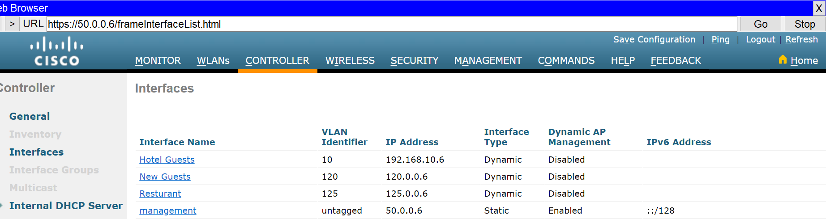
Guest WLC (50.0.0.6) Configuration
1-Interfaces

Slide 74
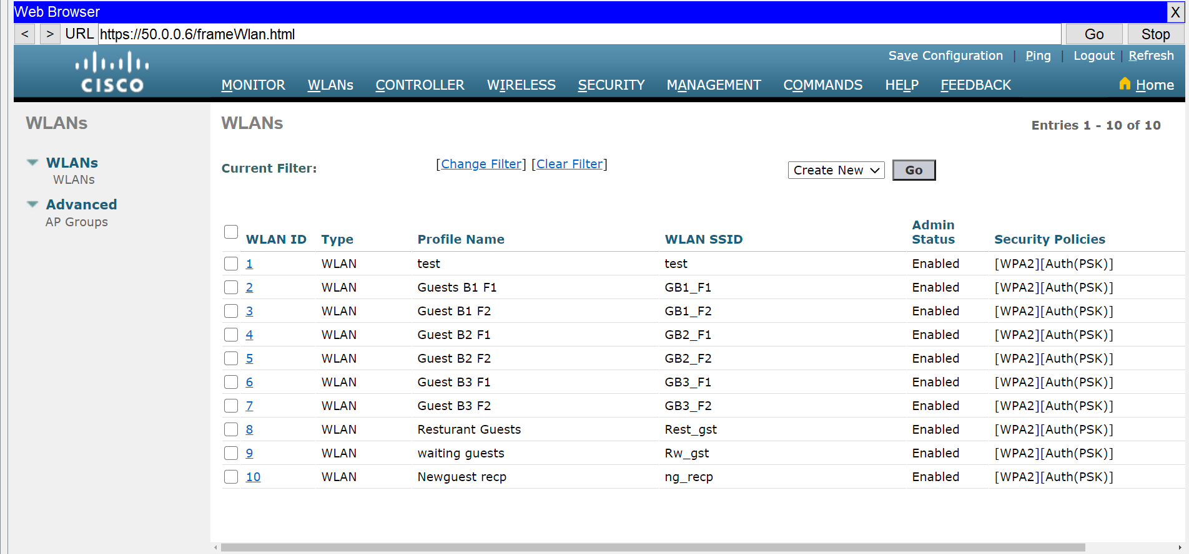
2- networks

Slide 75
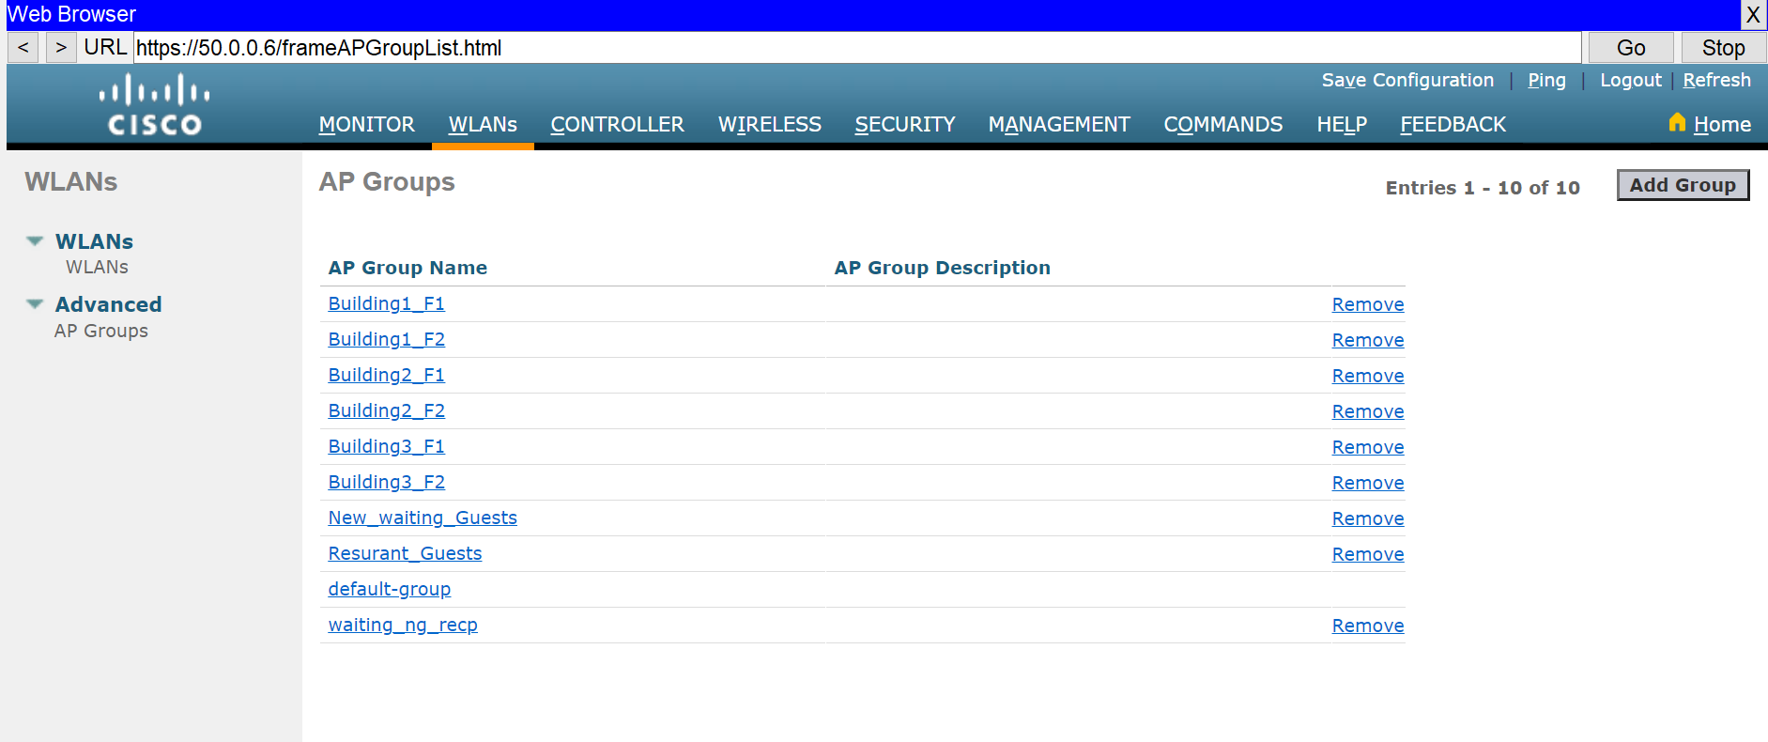
3-AP Groups

Slide 76
WLC2 (50.0.0.8) configuration
Manages wireless networks for internal hotel departments,including:
  Security
  HR Department
  Staff and Employees
  Management
Offers secure access to internal systems and services.
VLANs are configured per department for isolation and control.

Slide 77
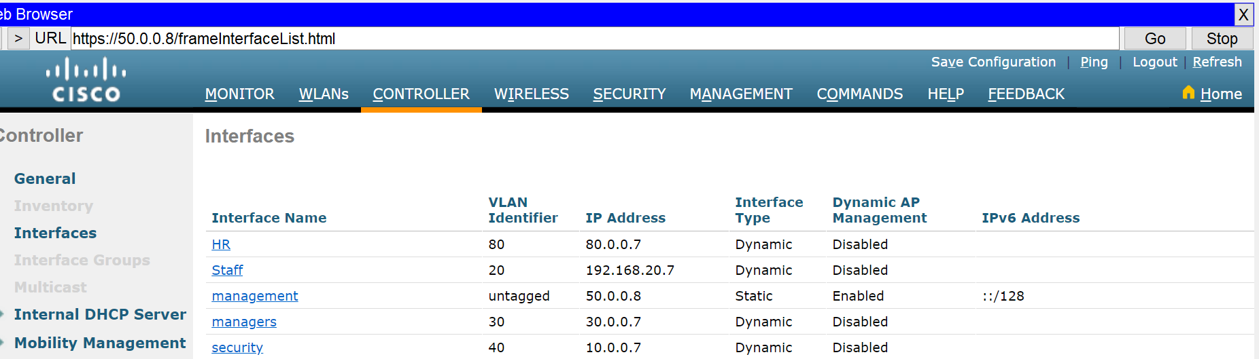
1-Interfaces

Slide 78
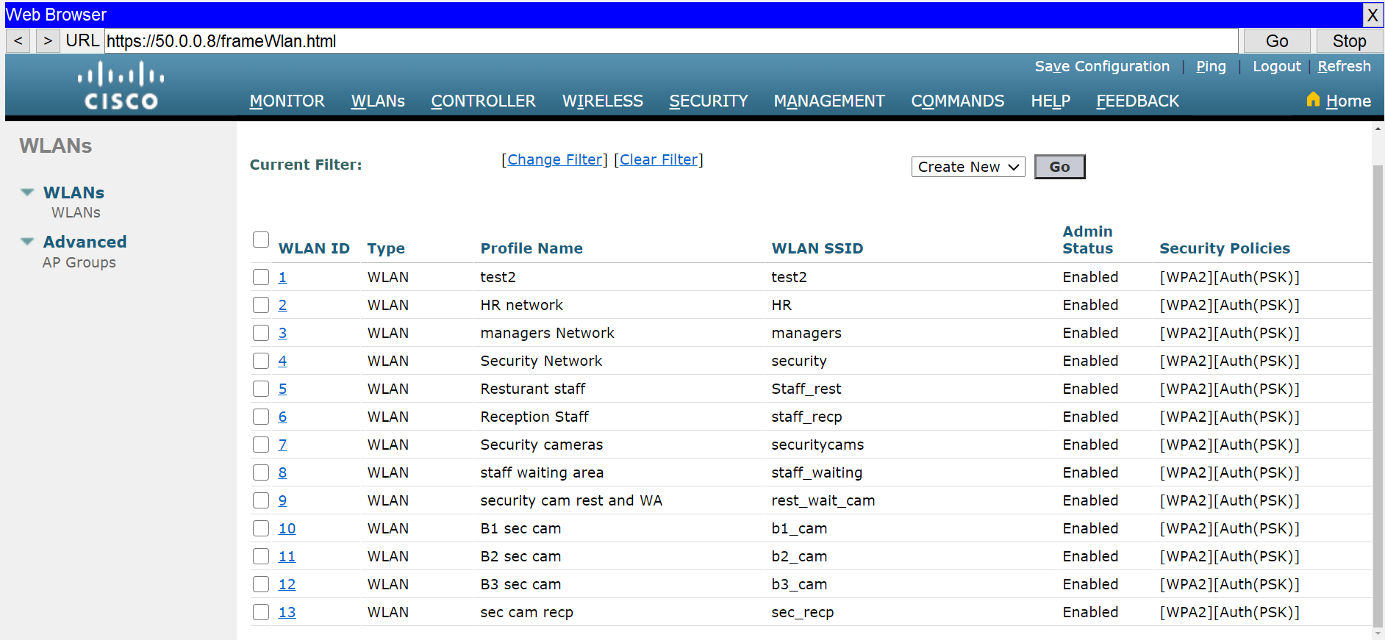
2-Networks

Slide 79
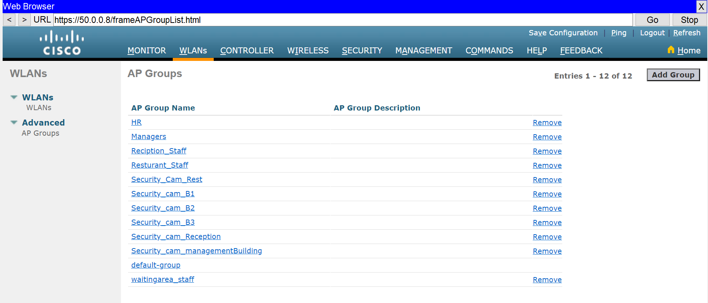
3-Ap Groups

Slide 80
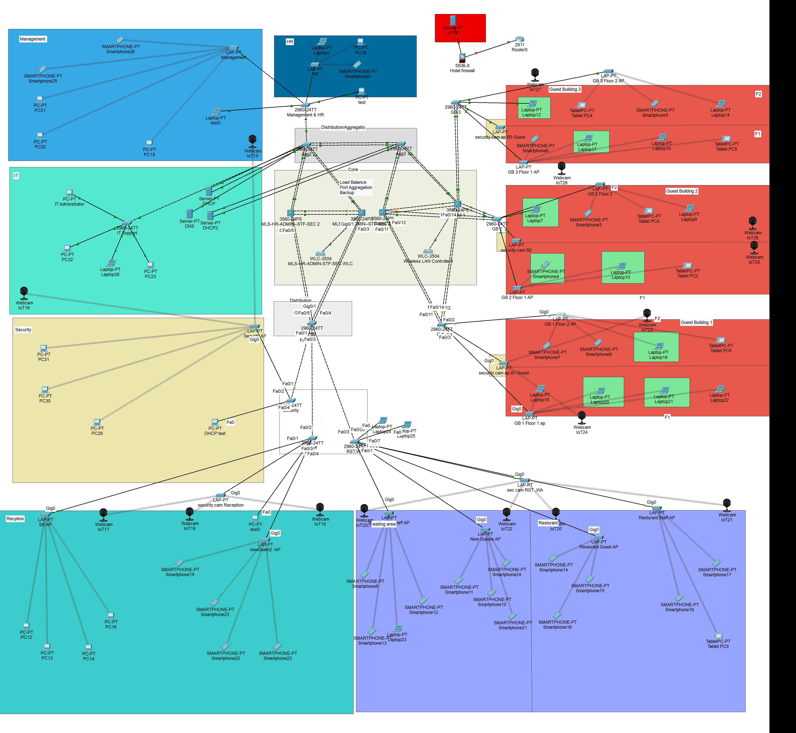
Network after configuration of wireless

Slide 81
SSH Configuration :
We have set up VLAN 150, named remote_access configured to access switches remotely through 2 pcs to test ssh configuration
- PC0 → 150.0.0.150
- PC32→ 150.0.0.20
Console Cable Connections for Device Access:
- PC23 is connected to MLS-HR-ADMIN--STF-SEC 2
- IT Administrator is connected to MLS-HR-ADMIN--STF-SEC 1

Slide 82
Management & HR Switch
VLAN 150 Configuration:
- IP Address: 150.0.0.30
- Subnet Mask: 255.255.255.0 (/24)
Hostname: manage
Domain: manage.com
Line Console Password: managehr
Enable Password: cisco@123
Username: managesw
Secret: manage1
SSH Access: line vty 0 2 (3 devices)
Interfaces:
- Shutdown: fa0/1 – 7 , fa0/9 - 22
Port Security applied on: fa0/8 , fa0/23

Slide 83
IT Support Switch
VLAN 150 Configuration:
- IP Address: 150.0.0.100
- Subnet Mask: 255.255.255.0 (/24)
Hostname: IT
IP Domain Name: IT.com
Line Console Password: itsupport
Enable Password: cisco@123
Username: it
Secret: itsw
SSH Access: line vty 0 2 (3 devices)
Interfaces:
- Shutdown : fa0/4 , fa0/6 – 24 , g0/2
Port Security applied on: fa0/1 , fa0/2 , fa0/3 , fa0/4 , fa0/5

Slide 84
Aggregation 1 Switch
VLAN 150 Configuration:
- IP Address: 150.0.0.15
- Subnet Mask: 255.255.255.0 (/24)
Hostname: Aggregation_1
IP Domain Name: Aggregation_1.com
Line Console Password: agg1
Enable Password: cisco@123
username: Agg1
secret: Agg1sw
SSH Access: line vty 0 2 (3 devices)
Interfaces:
- Shutdown : fa0/6– 24

Slide 85
Aggregation 2 Switch
VLAN 150 Configuration:
- IP Address: 150.0.0.16
- Subnet Mask: 255.255.255.0 (/24)
Hostname: Aggregation2
Domain: Aggregation2.com
Line Console Password: agg2
Enable Password: cisco@123
Username: Agg2
Secret: Agg2sw
SSH Access: line vty 0 2 (3 devices)
Interfaces:
- Shutdown : fa0/3 – 9 , fa0/12 - 14, fa0/16 - 19

Slide 86
Aggregation 3 Switch
VLAN 150 Configuration:
- IP Address: 150.0.0.17
- Subnet Mask: 255.255.255.0 (/24)
Hostname: Aggregation3
Domain: Aggregation3.com
Line Console Password: agg3
Enable Password: cisco@123
Username: Agg3
Secret: Agg3sw
SSH Access: line vty 0 2
Interfaces:
- Shutdown : fa0/1-3, fa0/6 - 9, fa0/11 - 14, fa0/16 - 20, fa0/23

Slide 87
MLS-HR-ADMIN--STF-SEC 1
VLAN 150 Configuration:
- IP Address: 150.0.0.1
- Subnet Mask: 255.255.255.0 (/24)
Hostname: Hotel_Core1
IP Domain Name: Hotel_Core1.com
Line Console Password: Core1
Enable Password: cisco@123
username: HotelCore1
secret: core1
SSH Access: line vty 0 2 (3 devices)
Interfaces:
- Shutdown : fa0/4 – 9 , fa0/12 – 24

Slide 88
MLS-HR-ADMIN--STF-SEC 2
VLAN 150 Configuration:
- IP Address: 150.0.0.2
- Subnet Mask: 255.255.255.0 (/24)
Hostname: Hotel_Core2
IP Domain Name: Hotel_Core2.com
Line Console Password: Core2
Enable Password: cisco@123
username: HotelCore2
secret: core2
SSH Access: line vty 0 2 (3 devices)
Interfaces:
- Shutdown : fa0/2-4 , fa0/6 – 19 , fa0/22 – 24

Slide 89
Guest 1 MLS
VLAN 150 Configuration:
- IP Address: 150.0.0.3
- Subnet Mask: 255.255.255.0 (/24)
Hostname: Guest_Core1
IP Domain Name: Guest_Core1.com
Line Console Password: Guest1
Enable Password: cisco@123
username: GuestCore1
secret: guest1
SSH Access: line vty 0 2 (3 devices)
Interfaces:
- Shutdown : fa0/3 , fa0/7– 9 , fa0/11 – 12 , fa0/15 , fa0/21 – 22

Slide 90
Guest 2 MLS
VLAN 150 Configuration:
- IP Address: 150.0.0.4
- Subnet Mask: 255.255.255.0 (/24)
Hostname: Guest_Core2
IP Domain Name: Guest_Core2.com
Line Console Password: Guest2
Enable Password: cisco@123
username: GuestCore2
secret: guest2
SSH Access: line vty 0 2 (3 devices)
Interfaces:
- Shutdown : fa0/1, fa0/6– 9 , fa0/13 – 20 , fa0/23 , g0/2

Slide 91
GB_1 Switch
VLAN 150 Configuration:
- IP Address: 150.0.0.5
- Subnet Mask: 255.255.255.0 (/24)
Hostname: GB_1
Domain: GB_1.com
Line Console Password: cisco1
Enable Password: cisco@123
Username: GB1
Secret: GB1sw
SSH Access: line vty 0 2 (3 devices)
Interfaces:
- Shutdown : fa0/4 - 10, fa0/15 - 20, fa0/22 – 24 , g0/1-2

Slide 92
GB_2 Switch
VLAN 150 Configuration:
- IP Address: 150.0.0.6
- Subnet Mask: 255.255.255.0 (/24)
Hostname: GB_2
Domain: GB_2.com
Line Console Password: cisco2
Enable Password: cisco@123
Username: GB2
Secret: GB2sw
SSH Access: line vty 0 2 (3 devices)
Interfaces:
- Shutdown : fa0/3 , fa0/5 - 9, fa0/11 - 14, fa0/19 – 21 , fa0/23 , g0/1-2
Port Security applied on: fa0/10

Slide 93
GB_3 Switch
VLAN 150 Configuration:
- IP Address: 150.0.0.7
- Subnet Mask: 255.255.255.0 (/24)
Hostname: GB_3
Domain: GB_3.com
Line Console Password: cisco3
Enable Password: cisco@123
Username: GB3
Secret: GB3sw
SSH Access: line vty 0 2 (3 devices)
Interfaces:
- Shutdown : fa0/4 , fa0/7 - 9, fa0/11 - 20, fa0/22 – 24
Port Security applied on: fa0/10

Slide 94
Security Switch
VLAN 150 Configuration:
- IP Address: 150.0.0.10
- Subnet Mask: 255.255.255.0 (/24)
Hostname: Security
Domain: Security.com
Line Console Password: Secsw
Enable Password: cisco@123
Username: sec
Secret: secsw
SSH Access: line vty 0 2 (3 devices)
Interfaces:
- Shutdown : fa0/3 , fa0/5 - 24, g0/1-2
Port Security applied on: fa0/4

Slide 95
Staff Switch
VLAN 150 Configuration:
- IP Address: 150.0.0.200
- Subnet Mask: 255.255.255.0 (/24)
Hostname: Staff
Domain: Staff.com
Line Console Password: staffsw
Enable Password: cisco@123
Username: staff
Secret: Staffsw
SSH Access: line vty 0 2 (3 devices)
Interfaces:
- Shutdown : fa0/5 – 19 , fa0/21 - 24 , g0/1-2
Port Security applied on: fa0/20

Slide 96
RST,WA Switch
VLAN 150 Configuration:
- IP Address: 150.0.0.125
- Subnet Mask: 255.255.255.0 (/24)
Hostname: Restaurant
Domain: Restaurant.com
Line Console Password: rst
Enable Password: cisco@123
Username: rest
Secret: restsw
SSH Access: line vty 0 2 (3 devices)
Interfaces:
- Shutdown : fa0/8 – 19 , fa0/21 - 24 , g0/1-2
Port Security applied on: fa0/5 , fa0/20

Slide 97
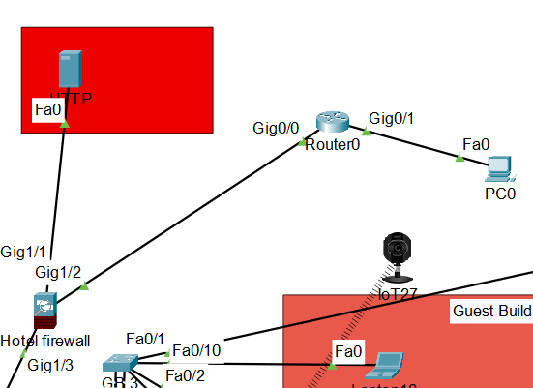
Firewall
Interface IP 192.168.1.1/24
DMZ Zone
Firewall Interface IP 100.100.100.2/30
HTTP/HTTPS Server have inside IP 192.168.1.10/24 and outside IP 100.100.100.10
Outside Zone
Interface IP 90.90.90.1/24
Inside Zone

